Slide 1

SRI INDU COLLEGE OF ENGINEERING AND TECHNOLOGY DEPARTMENT OF COMPUTER SCIENCE AND ENGINEERING BATCH: 2020-2024 MINI PROJECT-TITLE: PROTECTING CLOUD DATA WITH DYNAMIC SECURITY VIA NETWORK CODING
BATCH-09
TEAM MEMBERS:
20D41A0595:K.VANDANA
20D41A05A6:K.KRISHNA BABU
20D41A0568:G.REVANTH
UNDER THE GUIDANCE OF:
Mr. B.SURESH (ASSISTANT PROFESSOR)

Slide 2
CONTENTS:
ABSTRACT
INTRODUCTION
EXISTING SYSTEM
DISADVANTAGES
PROPOSED SYSTEM
ADVANTAGES
MODULES
SYSTEM REQUIREMENT
UML DIAGRAMS
SAMPLE CODE
SCREEN SHOTS OF EXECUTION
CONCLUSION

Slide 3

ABSTRACT:
Propose to use secure network coding techniques
to construct efficient and secure cloud storage protocols for
dynamic data, which can be updated, deleted, or
appended by the user
In this two protocols, DSCS I and DSCS II,
which are based on different secure network coding schemes
and have different properties and applications
To provide formal security proofs and prototype
implementations for their protocols, and show that they have
better performance than existing solutions.

Slide 4

INTRODUCTION:
Cloud computing allows clients to delegate computation and data storage to cloud servers.
Secure cloud storage protocols provide a mechanism to detect if the server stores the client's data untampered.
Secure network coding (SNC) protocols use cryptographic techniques to prevent these attacks.
This work investigates the problem of constructing a secure cloud storage protocol for dynamic data (DSCS) from a different perspective.
.

Slide 5
EXISTING SYSTEM:
To explore the possibility of using secure network coding (SNC) techniques to construct a secure cloud storage protocol for dynamic data (DSCS), which can handle updates, deletions, and modifications of outsourced data.
To build on the previous work of Chen et al. , who showed a connection between secure cloud storage and secure network coding for static data, but did not address the dynamic case.
To focus on the scenario where the client’s data are stored on a single server, rather than distributed across multiple servers, which is a different goal from most network coding based storage systems.
Disadvantages :
A client having a smart phone with a low-performance processor or limited storage cannot accomplish heavy computation or store large volume of data. Under such circumstances, she can delegate her computation/storage to the cloud server.
For static data, the client cannot change her data after the initial outsourcing (e.g., backup/archival data)

Slide 6
PROPOSED SYSTEM:
Explore the possibility of providing a generic construction of a DSCS protocol from any SNC protocol and discuss the challenges for a generic construction in details
We present two protocols, DSCS I and DSCS II, which are based on different SNC schemes and have different properties and applications. DSCS I is a generic protocol that supports arbitrary dynamic data, while DSCS II is a specialized protocol for append-only data.
To provide formal security definitions and proofs for both protocols, and show that they are secure in the standard model, without relying on the random oracle model.
Advantages :
Secure network coding (SNC) protocols use cryptographic techniques to prevent these attacks: the sender authenticates each packet by attaching a small tag to it.
We look at the problem of constructing a secure cloud storage protocol for dynamic data (DSCS) from a different perspective. We investigate whether we can construct an efficient DSCS protocol using an SNC protocol.

Slide 7
MODULES:
1.Data Owner
2.TPA(Third Party Auditor)
3.Cloud Server
1.Data Owner :
The data owner is the module that uploads and views the files securely on the cloud server, after registering and getting authorized by the cloud server.
2. TPA(Third Party Auditor) :
The TPA is the module that generates the auditing task for the users who request to access the files securely on the cloud server, after logging in directly with the application.
3.Cloud Server :
The cloud server is the module that operates the project and performs various operations, such as user activation, owner activation, search permission, top-k keyword and similarity analysis, after logging in.

Slide 8
SYSTEM REQUIREMENTS:
HARDWARE REQUIREMENTS:
Processor : 1GHz or faster CPU or System on a Chip (SoC) with two or more cores
RAM : 4GB
Hard drive : 64GB or larger.
System firmware : UEFI, Secure Boot capable.
TPM : Trusted Platform Module (TPM) version 2.0.
SOFTWARE REQUIREMENTS:
Operating system : Windows 10.
Coding Language : JAVA, HTML, CSS
Data Base: My SQL

Slide 9
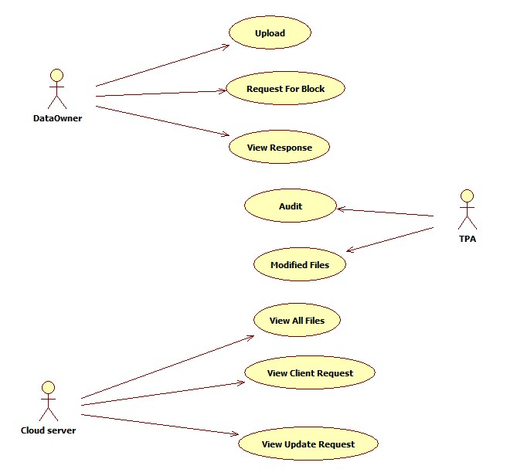
UML DIAGRAMS : UML stands for Unified Modeling Language. UML is a standardized general-purpose modeling language in the field of object-oriented software engineering.
USE CASE DIAGRAM :
A use case diagram in the Unified Modeling Language (UML)
is a type of behavioral diagram defined by and created from
a Use-case analysis.
Its purpose is to present a graphical
overview of the functionality provided by a system in
terms of actors, their goals (represented as use cases),
and any dependencies between those use cases

Slide 10
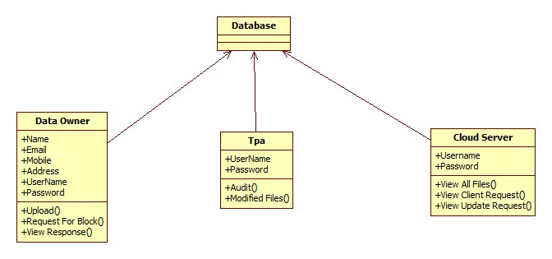
CLASS DIAGRAM: In software engineering, a class diagram in the Unified Modeling Language (UML) is a type of static structure diagram that describes the structure of a system by showing the system's classes, their attributes, operations (or methods), and the relationships among the classes.

Slide 11
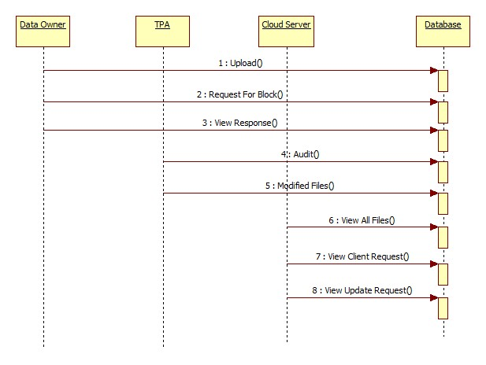
SEQUENCE DIAGRAM: A sequence diagram in Unified Modeling Language (UML) is a kind of interaction diagram that shows how processes operate with one another and in what order.

Slide 12
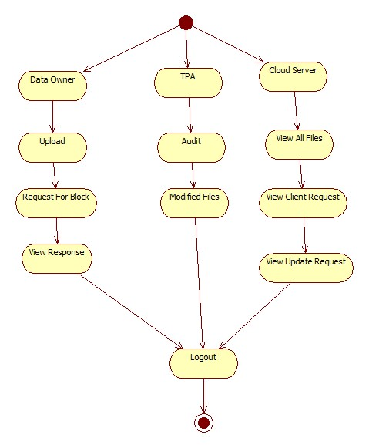
ACTIVITY DIAGRAM: Activity diagrams are graphical representations of workflows of stepwise activities and actions with support for choice, iteration and concurrency.

Slide 13
SAMPLE CODE
<%@page import="java. sql . Result Set"%>
<%@page import="com. database. Queries"%>
<%@page content Type="text/html" page Encoding="UTF-8"%>
<!DOCTYPE html>
<%
try{
String u name =request. Get Parameter("u name");
String pwd =request. Get Parameter(“ pwd");
String query="select * from owner where username=‘”+u name +“’ and password='"+pwd+"'";
Result Set i=Queries .get Execute Query(query);
if(i.next()){

Slide 14
session. Set Attribute("id", I . get String("id"));
session. Set Attribute("username", I . get String("username"));
session. Set Attribute("email“ , I .get String("email"));
%>
<script type='text/java script'>
window .alert("Login Successful...!!");
window. location="Owner Home . Jsp ";
</script>
<%
}else{
%>
<script type='text/java script'>
window .alert("Login Failed..!!");
window . location="Data Own er. jsp";
</script>
<%
}
}catch(Exception e){
out. Print ln(e); }
%>

Slide 15
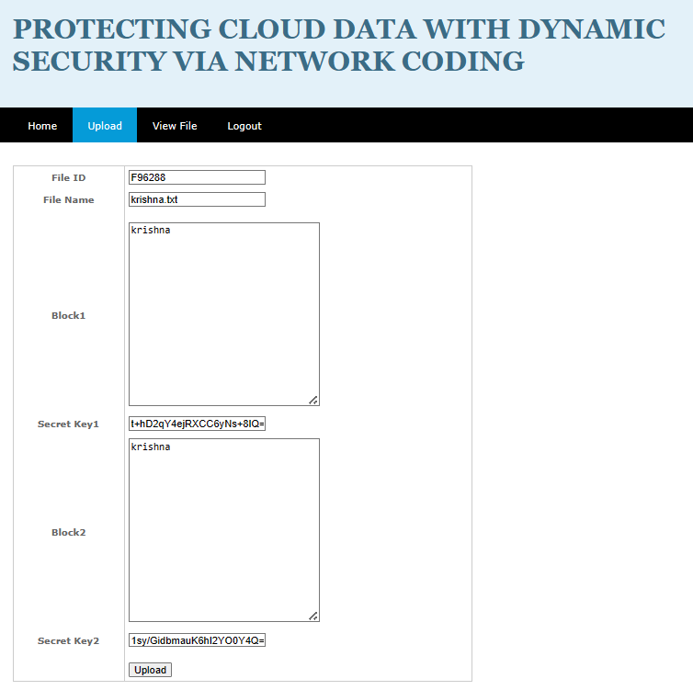
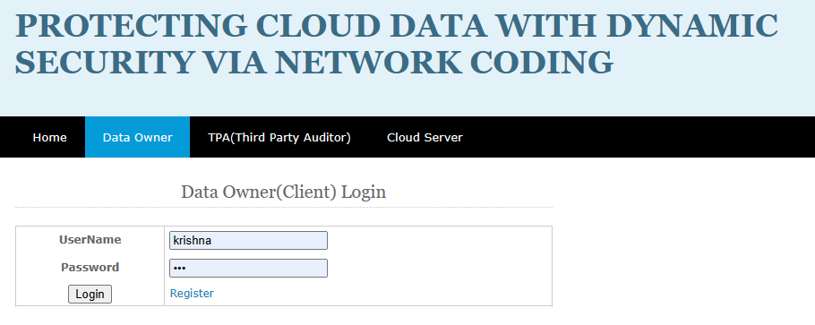
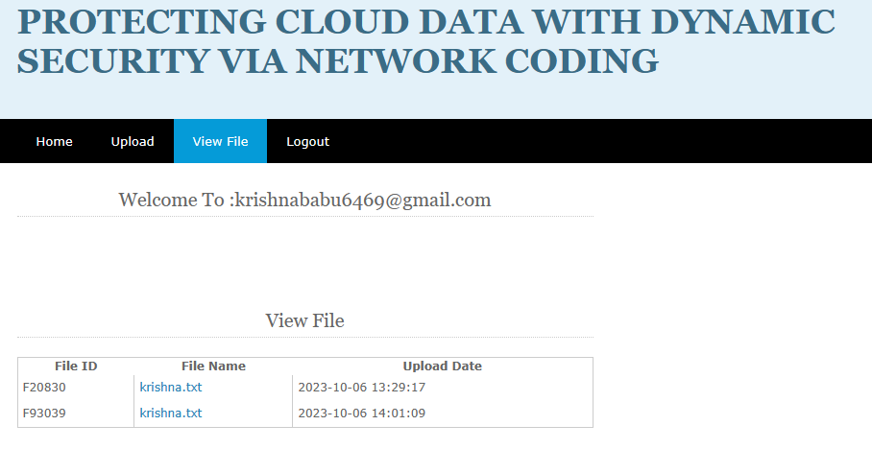
SCREEN SHOTS OF EXECUTION
DATA OWNER :

Slide 16
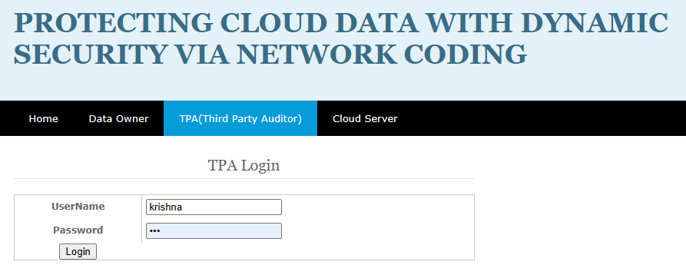
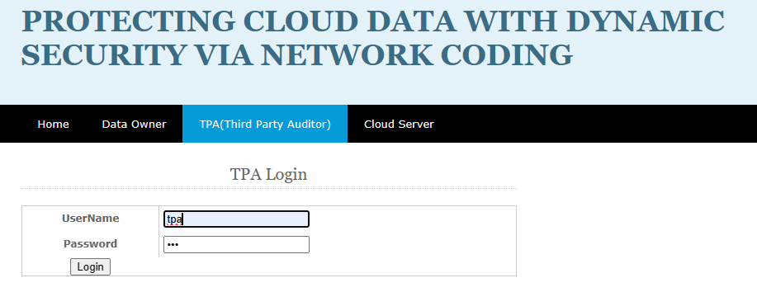
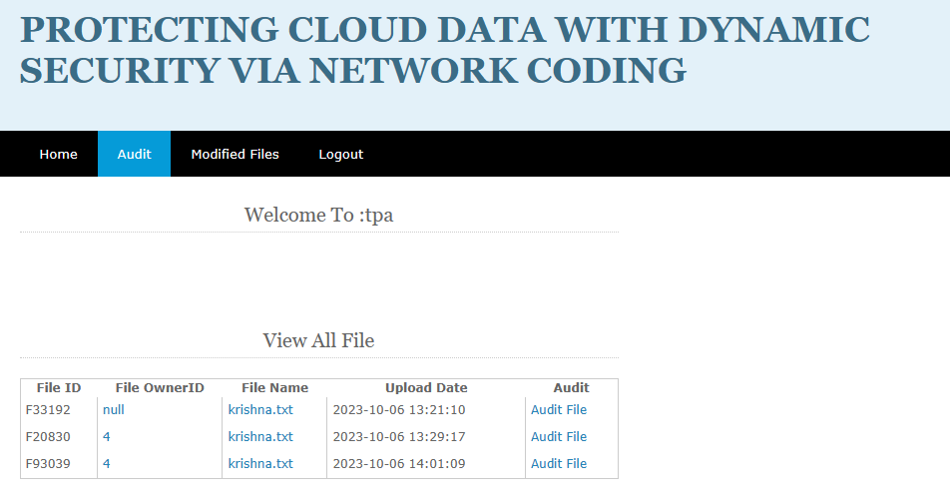
TPA: (THIRD PARTY AUDITOR)

Slide 17
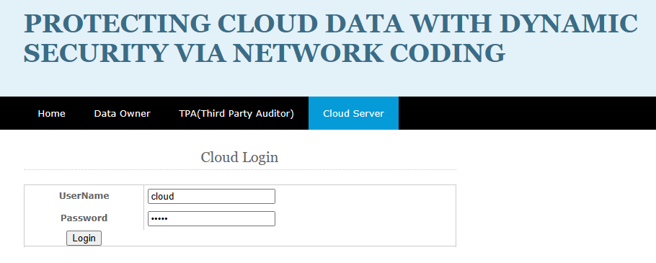
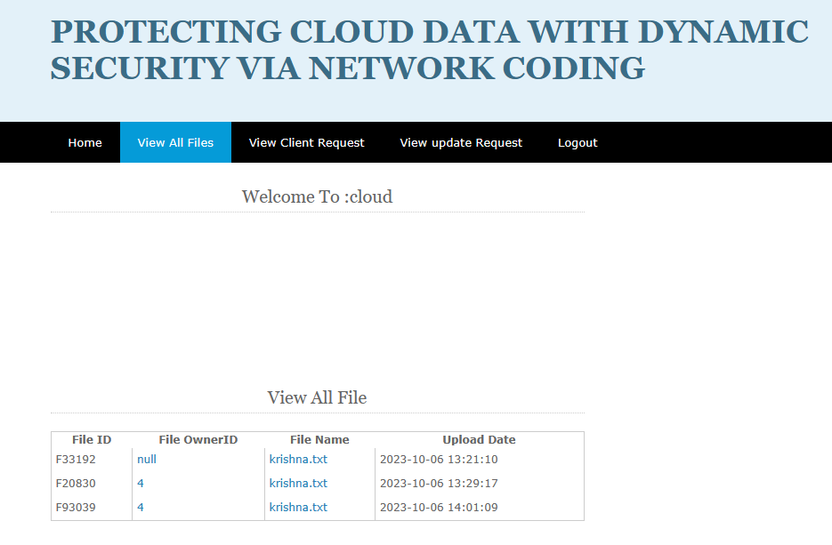
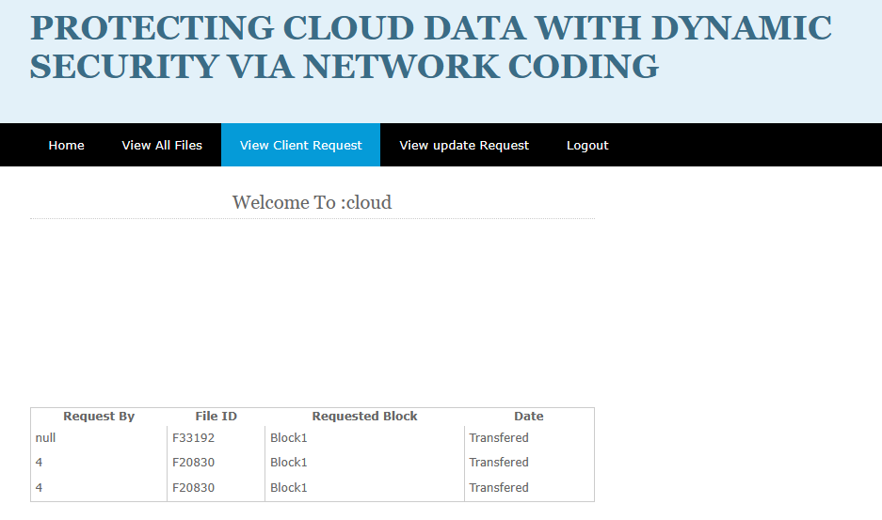
CLOUD SERVER :

Slide 18
CONCLUSION :
This work proposes a secure cloud storage protocol for dynamic data (DSCS I) based on a secure network coding (SNC) protocol, the first SNC-based DSCS protocol with public verifiability.
Challenges and limitations of SNC-based DSCS are discussed, with DSCS II designed for append-only data. Prototype implementations and performance comparisons are provided to demonstrate the practicality of these protocols.
The authors discuss challenges in constructing an efficient DSCS protocol from an SNC protocol and identify limitations of an SNC-based secure cloud storage protocol for dynamic data. They also identify SNC protocols suitable for append-only data and construct an efficient DSCS protocol (DSCS II) for append-only data. DSCS II overcomes some limitations of DSCS I. The authors provide prototype implementations to demonstrate their practicality and compare their performance with an SNC-based protocol.

Slide 19
Thank you

